Slide 1
MIDTERM PROJECT PROGRESS PRESENTATION
Dept of IT
Subject Code: PROJ-IT781
By
Group No : 5
Group Mentors:
Mr. Prodipta Bhowmik
&
Dr. Dibyendu Kumar Pal
Group Members:
1. Suvodeep Banerjee (13000221019)
2. Sougata Ghosh (13000221020)
3. Niladri Mondal (13000221022)
4. Suryansh Tilak (13000221024)

Slide 2
Cassava Leaf Disease Prediction and Classification
Objective
Classify each cassava image into four disease categories or a fifth category indicating a healthy leaf.
With this, farmers may be able to quickly identify diseased plants, potentially saving their crops before they inflict irreparable damage.

Slide 3




Tech Stack
Frontend:
HTML5 ,CSS3, JavaScript.
Backend:
Python, Flask , Tensorflow/Keras , Matplotlib , Pandas ,
Numpy , Scikit learn
Database:
Firebase Realtime Database
Deployment:
Heroku , Amazon AWS EC2 , Google Cloud

Slide 4
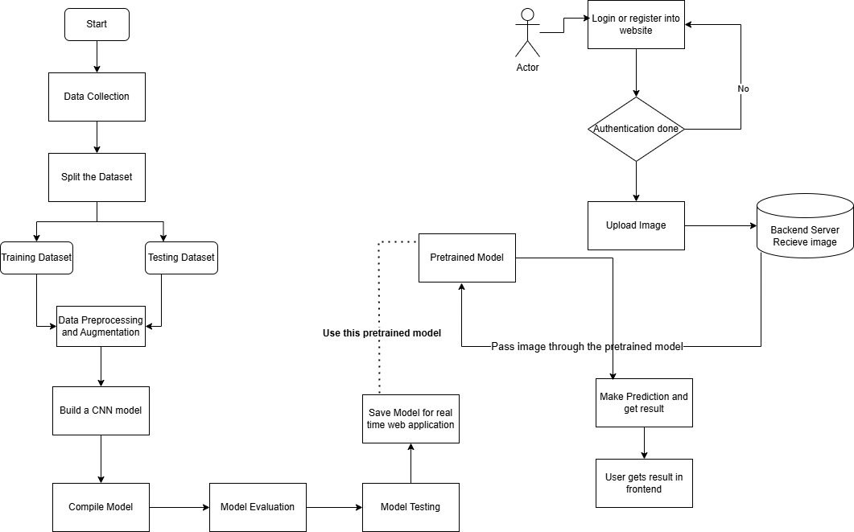
Architecture
Yes

Slide 5
Progress Till Date
Collection of image data from the web which consists of 21367 images
Preprocessing the dataset.
Training the model.
Prediction on a new image using the model

Slide 6
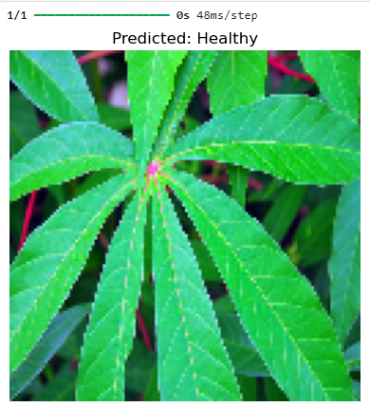
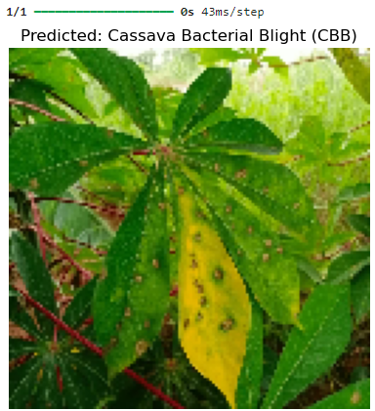
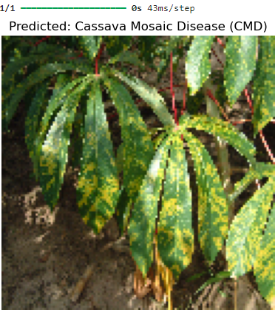
Results
The model is able to predict and classify the disease from the image provided to it with an validation accuracy of 70.83%
The directory of the image is to be provided to the prediction function and it provides the prediction and classification of the image along with the image displayed.

Slide 7
Future Scope
Creating an interactive user interface where a user can upload an image and the prediction would be displayed.
Trying to increase the accuracy of the model by optimization .
Primarily trying to check whether the image is indeed a cassava leaf or any other leaf.
Deployment of the web app on a Cloud Platform like AWS etc.

Slide 8
THANK YOU

